Slide 1
CS-513 - Knowledge Discovery and Data Mining
Analysis on Kickstarter Projects

Slide 2




Presented By -
Juhi Gurbani
Mohit Bhagchandani
Manan Satra
Ria Echhpal

Slide 3
Introduction
What is Kickstarter?
Kickstarter is a public-benefit corporation that maintains a crowdfunding platform focused on creativity and merchandising for projects
It maintains data regarding various enrolled startups, their basic summary about the category of startup, funding amounts, launched and deadline dates, state etc.

Slide 4
Executive Summary
Our dataset has projects classified as successful and failed. We aim to build a model such that we can predict the state of future projects.
Our model will also help the projects which have failed to improve by analyzing the successful projects and the key features that are responsible for the project to be successful.

Slide 5
Dataset - Kickstarter Projects
Data source - https://www.kaggle.com/kemical/kickstarter-projects
Total variables - 15; Total Rows: 65535
Variables used - 9; Rows used: 10536
Factors:
Main Category
Backers
USD pledged real
USD goal real
Launched Date
Deadline Date
Target Variable
State
Successful
Failed

Slide 6
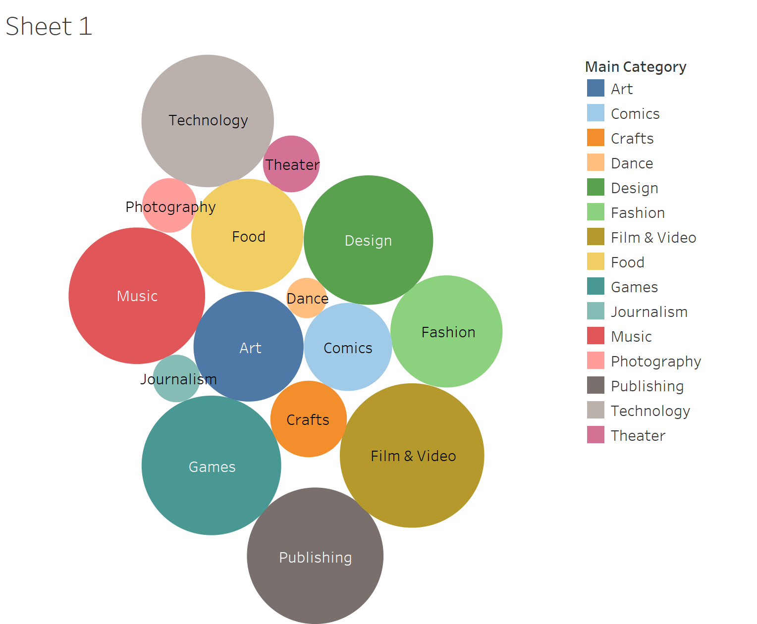

Slide 7
Preliminary Analysis
Duplicate columns with similar values were deleted
Filter out data only related to USA
Take only successful and failed startups into consideration
Data standardization
Notes:
s

Slide 8
Algorithm Process
Normalize the Dataset
Factor the data if needed
Split the dataset into training and test
Fit algorithm
Calculate the error rate

Slide 9
Algorithms Used
Naive Bayes
CART
C4.5
C5.0
KNN
KKNN
Random Forest

Slide 10
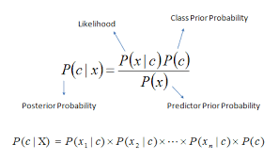
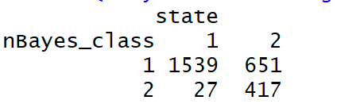
Algorithm 1 - Naive Bayes
Error rate = 0.2574032
Table -

Slide 11
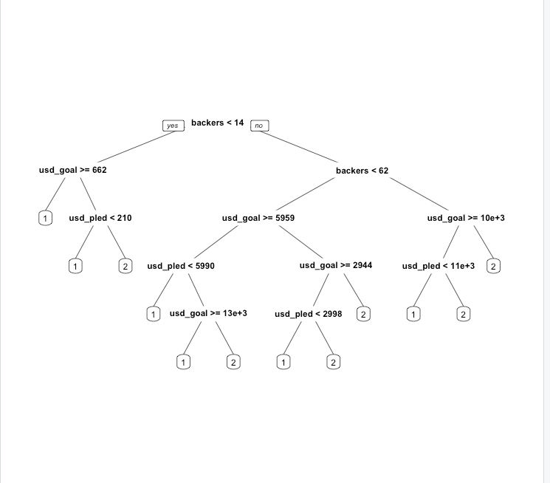
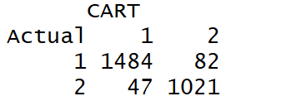
Algorithm 2 - CART
Table -
Error rate -
0.04897494

Slide 12
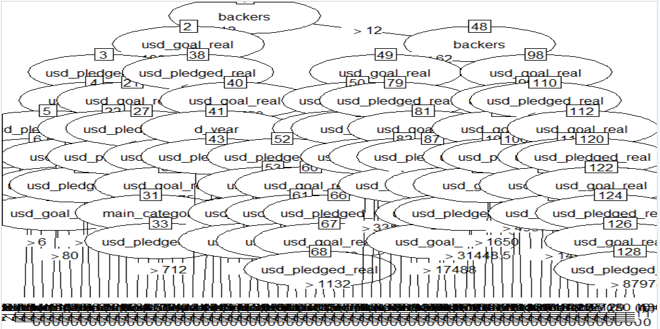
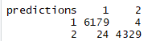
Algorithm 3 - C4.5
Error rate = 0.002657555
Table -

Slide 13
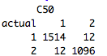
Algorithm 4 - C5.0
C5.0 is a classification technique
It is faster and requires less memory
Error Rate = 0.009111617
Table -

Slide 14
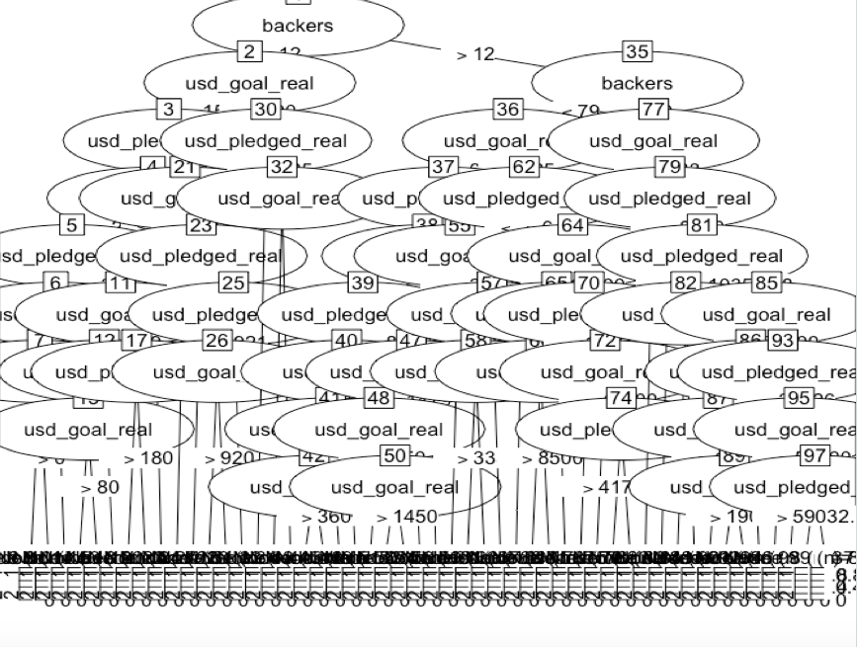
Algorithm 4 - C5.0

Slide 15
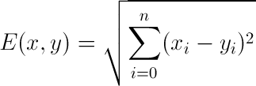
Algorithm 5 - KNN
KNN (k-Nearest Neighbors)
Supervised algorithm where a target variable is specified
Target variable - state of the projects (Successful/failed)
k-nearest neighbors are found using Euclidean distance -

Slide 16
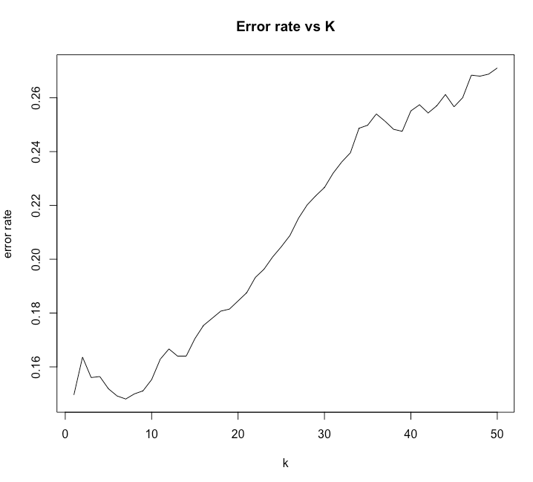
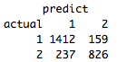
Algorithm 5 - KNN
1. Error rate with k=8 -
[1] 0.1503417
Table -

Slide 17
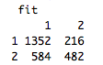
Algorithm 6 - KKNN
Error rate = 0.3037206
Table -

Slide 18
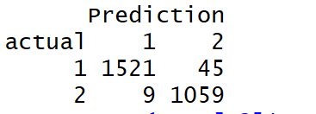
Algorithm 7 - Random Forest
Random Forest is an algorithm that develops decision trees based on random selection of data and variables.
1. Number of tree(ntrees) = 1000
Error rate = 0.02050114
Table -
2. Number of tree(ntrees) = 2000
Error rate = 0.02050114
Table -

Slide 19
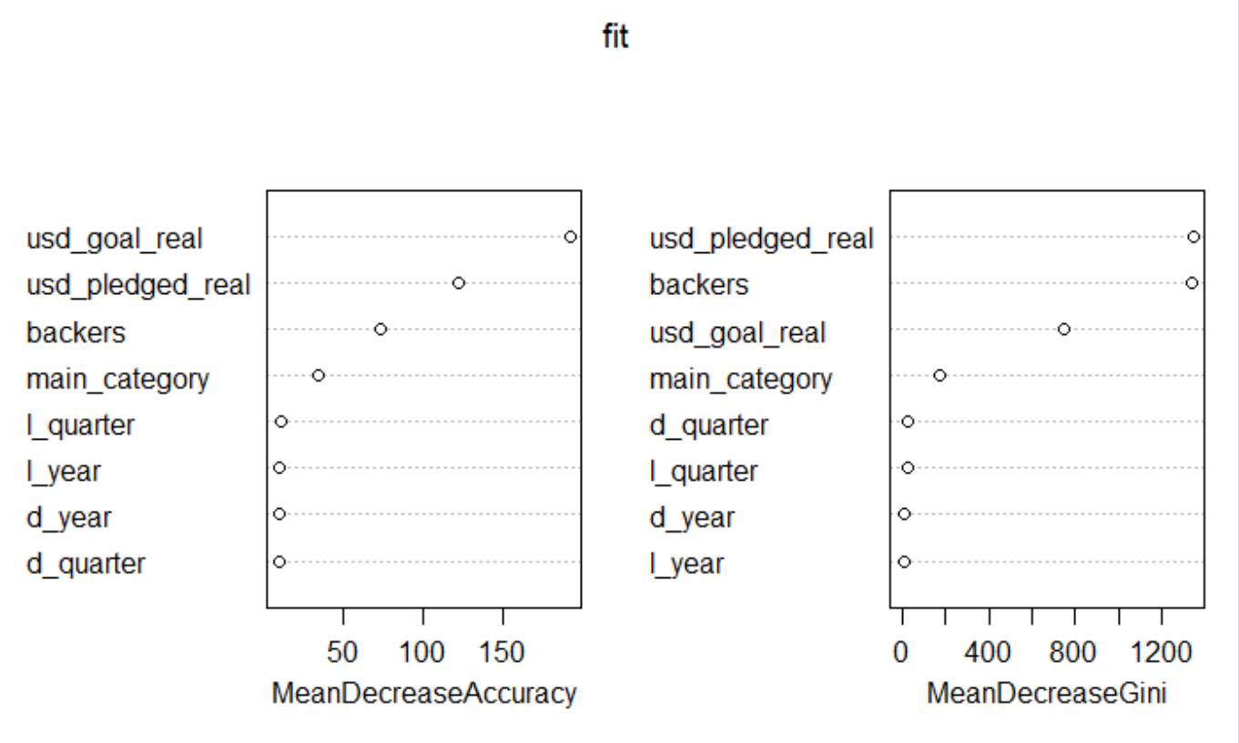
Algorithm 7 - Random Forest

Slide 20
Conclusion
Algorithm | Error Rate
KNN(K=8) | 0.1503417
Random Forest(n=3000) | 0.01746393
CART | 0.04897494
C4.5 | 0.002657555
C5.0 | 0.009111617
KKNN | 0.3037206
Naive Bayes | 0.2574032

Slide 21
Future Scope
We would try running the model on live projects from Kickstarter
We would also include the Cancelled and Suspended states to produce better accuracy
We would try running Neural Nets on our data.

Slide 22
Thank You
Questions?

Slide 23
Preliminary Analysis Code
rm(list=ls()) set.seed(123) Startup_Raw<-read.csv("D:\\HIGHER STUDIES\\Stevens\\MS SEM 2\\CS 513 KDD\\Project\\KDD Project Share\\Data sets and R code\\Final Dataset\\Startup_Raw.csv") Startup_Raw1<-Startup_Raw[(!(Startup_Raw$state=="live") & !(Startup_Raw$state=="canceled") & !(Startup_Raw$state=="suspended") & (Startup_Raw$country=="US")),] Startup_Raw1<-Startup_Raw1[,c(-1,-2,-3,-5,-7,-9,-12,-13)] Startup_Raw1<-Startup_Raw1[(substring(Startup_Raw1$deadline,7,8)=="16"|substring(Startup_Raw1$deadline,7,8)=="17"|substring(Startup_Raw1$deadline,7,8)=="18"),] Startup_Raw1<-Startup_Raw1[(substring(Startup_Raw1$launched,7,8)=="16"|substring(Startup_Raw1$launched,7,8)=="17"),] Startup_Raw1$deadline <- strptime(as.character(Startup_Raw1$deadline), "%m/%d/%y") Startup_Raw1$deadline <- as.Date(Startup_Raw1$deadline) Startup_Raw1$launched <- strptime(as.character(Startup_Raw1$launched), "%m/%d/%y") Startup_Raw1$launched <- as.Date(Startup_Raw1$launched) library(zoo) Startup_Raw1$launched <- as.yearqtr(Startup_Raw1$launched, format = "%Y-%m-%d") Startup_Raw1$deadline <- as.yearqtr(Startup_Raw1$deadline, format = "%Y-%m-%d") Startup_Raw1$deadline = as.character(Startup_Raw1$deadline) Startup_Raw1 <- cbind(Startup_Raw1, do.call("rbind", strsplit(Startup_Raw1[, 2], " "))) Startup_Raw1<- Startup_Raw1[, -2] colnames(Startup_Raw1)[7] <- "d_year" colnames(Startup_Raw1)[8] <- "d_quarter" Startup_Raw1$launched = as.character(Startup_Raw1$launched) Startup_Raw1 <- cbind(Startup_Raw1, do.call("rbind", strsplit(Startup_Raw1[,2], " "))) Startup_Raw1<- Startup_Raw1[, -2] colnames(Startup_Raw1)[8] <- "l_year" colnames(Startup_Raw1)[9] <- "l_quarter" Startup_Raw1$d_quarter<-as.numeric(factor(Startup_Raw1$d_quarter,levels=(c("Q1","Q2","Q3","Q4")))) Startup_Raw1$l_quarter<-as.numeric(factor(Startup_Raw1$l_quarter,levels=(c("Q1","Q2","Q3","Q4")))) Startup_Raw1$main_category<-as.numeric(factor(Startup_Raw1$main_category,levels=(c("Art","Comics","Crafts","Dance","Design","Fashion","Film & Video","Food","Games","Journalism","Music","Photography","Publishing","Technology","Theater")))) Startup_Raw1$state<-as.numeric(factor(Startup_Raw1$state,levels=(c("failed","successful"))))

Slide 24
C4.5 Code
Startup_Raw1$state<-factor(Startup_Raw1$state,levels=(c("1","2"))) #install.packages("RWeka") library(RWeka) # fit model idx<-sort(sample(nrow(Startup_Raw1),as.integer(.75*nrow(Startup_Raw1))))
training<-Startup_Raw1[idx,]
test<-Startup_Raw1[-idx,]
fit <- J48(state~., data=training)
# summarize the fit
summary(fit)
plot(fit)
# make predictions
predictions <- predict(fit, test[,-2])
# summarize accuracy
table(predictions, test$state)
wrong<- (test$state!=predictions)
error_rate<-sum(wrong)/length(wrong)
error_rate

Slide 25
C5.0 Code
Startup_Raw1$state<-factor(Startup_Raw1$state,levels=(c("1","2"))) library('C50') idx<-sort(sample(nrow(Startup_Raw1),as.integer(.75*nrow(Startup_Raw1)))) training<-Startup_Raw1[idx,] test<-Startup_Raw1[-idx,] C50_class <- C5.0( state~.,data=training ) summary(C50_class ) plot(C50_class) C50_predict<-predict( C50_class ,test , type="class" ) table(actual=test[,2],C50=C50_predict) wrong<- (test[,2]!=C50_predict) c50_rate<-sum(wrong)/length(test[,2]) c50_rate

Slide 26
KNN Code
Startup_Raw1$main_category<-as.factor(Startup_Raw1$main_category)
Startup_Raw1$d_year<-as.factor(Startup_Raw1$d_year)
Startup_Raw1$d_quarter<-as.factor(Startup_Raw1$d_quarter)
Startup_Raw1$l_year<-as.factor(Startup_Raw1$l_year)
Startup_Raw1$l_quarter<-as.factor(Startup_Raw1$l_quarter)
Startup_Raw1<-na.omit(Startup_Raw1)
idx<-sort(sample(nrow(Startup_Raw1),as.integer(.75*nrow(Startup_Raw1))))
training<-Startup_Raw1[idx,]
test<-Startup_Raw1[-idx,]
predict<-knn(training[,-2],test[,-2],training[,2],k=8)
table(actual=test[,2],predict)
wrong<- (test[,2]!=predict)
error_rate<-sum(wrong)/length(wrong)
#install.packages("class")
library(class)
errors<-c()
ks <- seq(from = 1, to = 50, by = 1)
for (i in ks) {
# Predicting
predict<-knn(training[,-2],test[,-2],training[,2],k=i)
wrong<- (test[,2]!=predict)
error_rate<-sum(wrong)/length(wrong)
errors <- append(errors, error_rate)
}
plot(ks, errors, type='l', main="Error rate vs K", xlab="k", ylab="error rate")

Slide 27
Random Forest Code
Startup_Raw1$state<-factor(Startup_Raw1$state,levels=(c("1","2")))
Startup_Raw1$main_category<-as.factor(Startup_Raw1$main_category)
Startup_Raw1$d_year<-as.factor(Startup_Raw1$d_year)
Startup_Raw1$d_quarter<-as.factor(Startup_Raw1$d_quarter)
Startup_Raw1$l_year<-as.factor(Startup_Raw1$l_year)
Startup_Raw1$l_quarter<-as.factor(Startup_Raw1$l_quarter)
Startup_Raw1<-na.omit(Startup_Raw1)
idx<-sort(sample(nrow(Startup_Raw1),as.integer(.75*nrow(Startup_Raw1))))
training<-Startup_Raw1[idx,]
test<-Startup_Raw1[-idx,]
#install.packages("randomForest")
library(randomForest)
fit <- randomForest(state~main_category+backers+usd_pledged_real+usd_goal_real+d_year+d_quarter+l_year+l_quarter, data=training, importance=TRUE, ntree=1000)
importance(fit)
varImpPlot(fit)
Prediction <- predict(fit, test)
table(actual=test[,2],Prediction)
wrong<- (test[,2]!=Prediction )
error_rate<-sum(wrong)/length(wrong)
error_rate

Slide 28
KKNN Code
raw_normalized<-as.data.frame (
cbind( main_category= as.factor(Startup_Raw1$main_category),state=as.character(Startup_Raw1[,2]), backers=mmnorm(Startup_Raw1[,3],min(as.numeric(Startup_Raw1[,3])),max(as.numeric(Startup_Raw1[,3])))
, usd_pledged_real=mmnorm(Startup_Raw1[,4],min(as.numeric(Startup_Raw1[,4])),max(as.numeric(Startup_Raw1[,4]) ))
,usd_goal_real=mmnorm(Startup_Raw1[,5],min(as.numeric(Startup_Raw1[,5])),max(as.numeric(Startup_Raw1[,5])))
,d_year = as.factor(Startup_Raw1[,6]),d_quarter = Startup_Raw1[,7], l_year = Startup_Raw1[,8],l_quarter=Startup_Raw1[,9]))
idx<-sort(sample(nrow(raw_normalized),as.integer(.75*nrow(raw_normalized))))
training<-raw_normalized[idx,]
test<-raw_normalized[-idx,]
library(kknn)
predict_k5 <- kknn(formula=state~., training, test, k=5,kernel ="triangular" )
fit <- fitted(predict_k5)
table(test$state,fit)
kknn_wrong<-sum(test[,2]!=fit)
kknn_error_rate<-kknn_wrong/length(test[,2])
kknn_error_rate

Slide 29
Naive Bayes Code
Startup_Raw1$state<-factor(Startup_Raw1$state,levels=(c("1","2"))) Startup_Raw1$main_category<-as.factor(Startup_Raw1$main_category) Startup_Raw1$d_year<-as.factor(Startup_Raw1$d_year) Startup_Raw1$d_quarter<-as.factor(Startup_Raw1$d_quarter) Startup_Raw1$l_year<-as.factor(Startup_Raw1$l_year) Startup_Raw1$l_quarter<-as.factor(Startup_Raw1$l_quarter) Startup_Raw1<-na.omit(Startup_Raw1) idx<-sort(sample(nrow(Startup_Raw1),as.integer(.75*nrow(Startup_Raw1)))) training<-Startup_Raw1[idx,] test<-Startup_Raw1[-idx,] library(class) library(e1071) nBayes_class <- naiveBayes(state ~main_category+backers+d_year+d_quarter+usd_pledged_real+usd_goal_real+l_year+l_quarter, data =training) category_all<-predict(nBayes_class,test[,-2]) table(nBayes_class=category_all,state= test$state) NB_wrong<-sum(category_all!=test$state) NB_error_rate<-NB_wrong/length(category_all) NB_error_rate

Slide 30
CART Code
Startup_Raw1$state<-factor(Startup_Raw1$state,levels=(c("1","2"))) idx<-sort(sample(nrow(Startup_Raw1),as.integer(.75*nrow(Startup_Raw1)))) training<-Startup_Raw1[idx,] test<-Startup_Raw1[-idx,] library(rpart) library(rpart.plot) # Enhanced tree plots library(rattle) # Fancy tree plot library(RColorBrewer) # colors needed for rattle CART_class<-rpart( state~.,data=training,method="class") prp(CART_class) # summary(CART_class) # text(CART_class) # rpart.plot(CART_class) # plotcp(CART_class) CART_predict<-predict(CART_class,test, type='class') table(Actual=test[,2],CART=CART_predict) CART_wrong<-sum(test[,2]!=CART_predict) CART_error_rate<-CART_wrong/length(test[,2]) CART_error_rate

